Slide 1
ScholarlyDB:
A SQL Approach
to Educational Metrics
BDM Final Project, Spring 2025
Group: Niketan Baranwal, Geetika Padala, Deniz Zeran, and Keyu (Kevin) Chen

Slide 2
About the Project
This dataset captures detailed academic and behavioral information about high school students. Each row represents a unique student, with fields covering demographics, academic engagement, extracurricular involvement, and performance metrics.

Slide 3
What we are working on?
Design
Database
Implement
SQL Queries
Visualize Key Insights

Slide 4
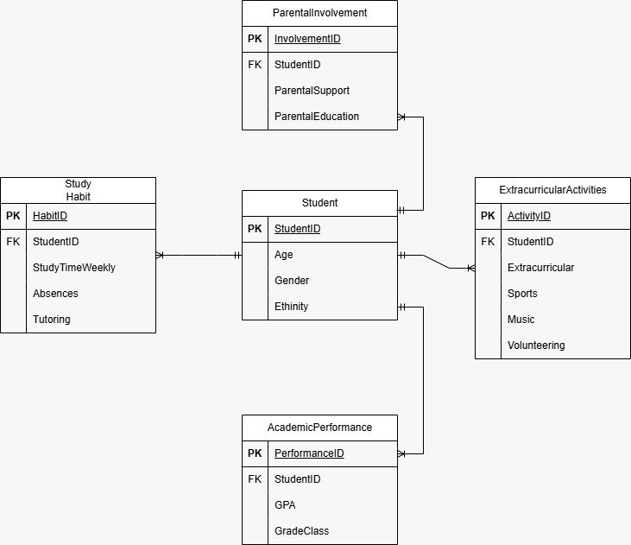
ER DIAGRAM

Slide 5
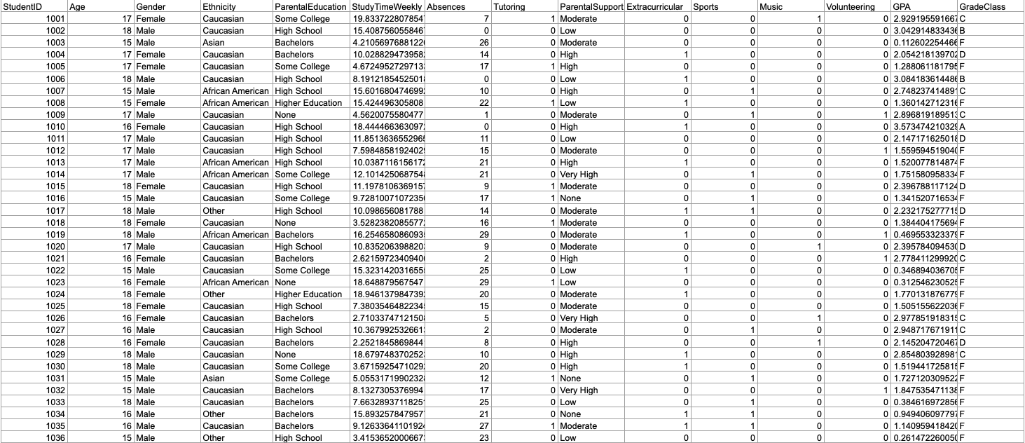
DATASET EXAMPLE

Slide 6
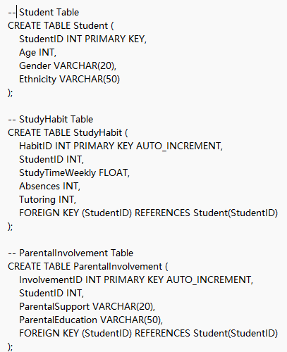
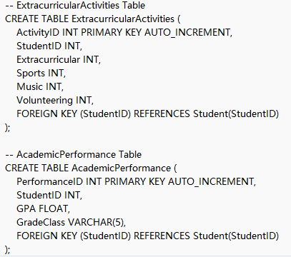
Implementation in SQL

Slide 7

DATASET EXAMPLE

Slide 8
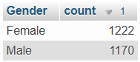
SQL QUESTION #1
Distribution of students by gender.
SELECT Gender, COUNT(*) AS count
FROM Student
GROUP BY Gender
ORDER BY count DESC;

Slide 9
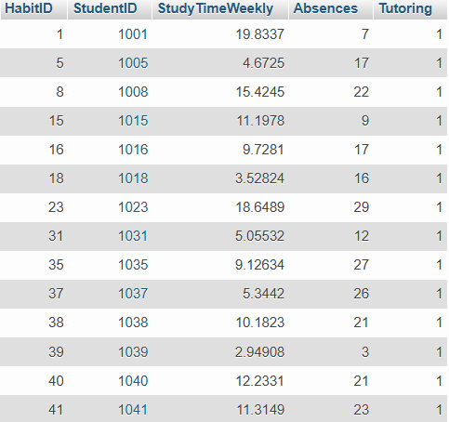
SQL QUESTION #2
List all students who have received tutoring.
SELECT *
FROM StudyHabit
WHERE Tutoring = 1;
Notes:
Niketan

Slide 10
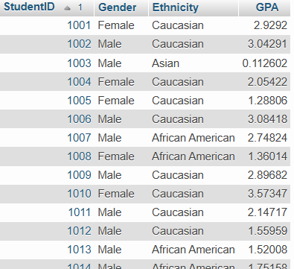
SQL QUESTION #3
List students with their ethnicity.
SELECT s.StudentID, s.Gender, s.Ethnicity, ap.GPA
FROM Student s
JOIN AcademicPerformance ap ON s.StudentID = ap.StudentID
ORDER BY s.StudentID;

Slide 11
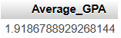
SQL QUESTION #4
Find the average GPA of male students.
SELECT AVG(GPA) AS Average_GPA FROM AcademicPerformance JOIN Student ON AcademicPerformance.StudentID = Student.StudentID WHERE Gender = 'Male';
Notes:
Niketan

Slide 12
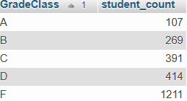
SQL QUESTION #5
Count of students by grade class.
SELECT GradeClass, COUNT(*) AS student_count
FROM AcademicPerformance
GROUP BY GradeClass
ORDER BY GradeClass;

Slide 13
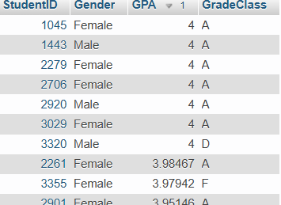
SQL QUESTION #6
Find students with GPA above 3.0.
SELECT s.StudentID, s.Gender, ap.GPA, ap.GradeClass
FROM Student s
JOIN AcademicPerformance ap ON s.StudentID = ap.StudentID
WHERE ap.GPA > 3.0
ORDER BY ap.GPA DESC;

Slide 14
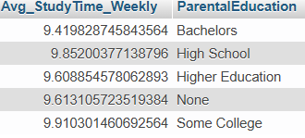
SQL QUESTION #7
Find the average study time per week for students grouped by parental education level.
SELECT AVG(StudyTimeWeekly) AS Avg_StudyTime_Weekly, ParentalEducation FROM StudyHabit JOIN ParentalInvolvement ON StudyHabit.StudentID = ParentalInvolvement.StudentID GROUP BY ParentalEducation;
Notes:
Niketan

Slide 15
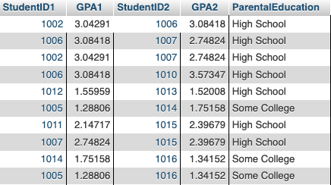
SQL QUESTION #8
Find all pairs of students who have the same ParentalEducation level and whose GPA differs by less than 0.5. List their IDs and GPAs.
SELECT s1.StudentID AS StudentID1, ap1.GPA AS GPA1, s2.StudentID AS StudentID2, ap2.GPA AS GPA2, p1.ParentalEducation FROM AcademicPerformance ap1 JOIN ParentalInvolvement p1 ON ap1.StudentID = p1.StudentID JOIN AcademicPerformance ap2 ON ap1.StudentID < ap2.StudentID JOIN ParentalInvolvement p2 ON ap2.StudentID = p2.StudentID JOIN Student s1 ON ap1.StudentID = s1.StudentID JOIN Student s2 ON ap2.StudentID = s2.StudentID WHERE p1.ParentalEducation = p2.ParentalEducation AND ABS(ap1.GPA - ap2.GPA) < 0.5;
Notes:
Niketan

Slide 16
SQL QUESTION #9 PART #1
Create a trigger to log a warning into a separate AbsenceWarnings table whenever a student has more than 15 absences.
CREATE TABLE AbsenceWarnings (
StudentID INT,
Absences INT,
WarningDate DATETIME DEFAULT CURRENT_TIMESTAMP
);
Notes:
Niketan

Slide 17
SQL QUESTION #9 PART #2
Create a trigger to log a warning into a separate AbsenceWarnings table whenever a student has more than 15 absences.
DELIMITER $$
CREATE TRIGGER log_absence_warning AFTER INSERT ON StudyHabit FOR EACH ROW
BEGIN
IF NEW.Absences > 15 THEN
INSERT INTO AbsenceWarnings (StudentID, Absences)
VALUES (NEW.StudentID, NEW.Absences);
END IF;
END$$
DELIMITER ;
Notes:
Delimiter tells MYSQL “Don’t end the command when you see a semicolon—wait until you see my custom delimiter (like $$ or //).” Niketan

Slide 18
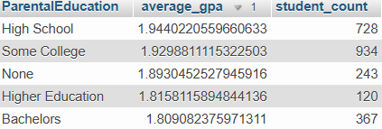
SQL QUESTION #10
Average GPA by parental education level.
SELECT pi.ParentalEducation, AVG(ap.GPA) AS average_gpa, COUNT(*) AS student_count
FROM Student s
JOIN AcademicPerformance ap ON s.StudentID = ap.StudentID
JOIN ParentalInvolvement pi ON s.StudentID = pi.StudentID
GROUP BY pi.ParentalEducation
ORDER BY average_gpa DESC;

Slide 19
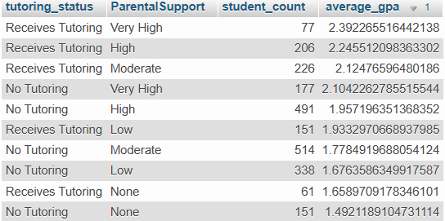
SQL QUESTION #11
Effect of tutoring and parental support.
SELECT
CASE
WHEN sh.Tutoring = 1 THEN 'Receives Tutoring'
ELSE 'No Tutoring'
END AS tutoring_status,
pi.ParentalSupport,
COUNT(*) AS student_count,
AVG(ap.GPA) AS average_gpa
FROM Student s
JOIN StudyHabit sh ON s.StudentID = sh.StudentID
JOIN ParentalInvolvement pi ON s.StudentID = pi.StudentID
JOIN AcademicPerformance ap ON s.StudentID = ap.StudentID
GROUP BY tutoring_status, pi.ParentalSupport
ORDER BY average_gpa DESC;

Slide 20
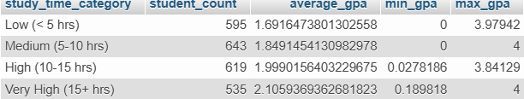
SQL QUESTION #12
Impact of study time on GPA.
SELECT
CASE
WHEN sh.StudyTimeWeekly < 5 THEN 'Low (< 5 hrs)'
WHEN sh.StudyTimeWeekly >= 5 AND sh.StudyTimeWeekly < 10 THEN 'Medium (5-10 hrs)'
WHEN sh.StudyTimeWeekly >= 10 AND sh.StudyTimeWeekly < 15 THEN 'High (10-15 hrs)'
ELSE 'Very High (15+ hrs)'
END AS study_time_category,
COUNT(*) AS student_count,
AVG(ap.GPA) AS average_gpa,
MIN(ap.GPA) AS min_gpa,
MAX(ap.GPA) AS max_gpa
FROM Student s
JOIN StudyHabit sh ON s.StudentID = sh.StudentID
JOIN AcademicPerformance ap ON s.StudentID = ap.StudentID
GROUP BY study_time_category
ORDER BY AVG(sh.StudyTimeWeekly);

Slide 21
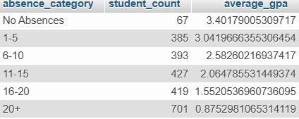
SQL QUESTION #13
Relationship between absences and GPA
SELECT
CASE
WHEN sh.Absences = 0 THEN 'No Absences'
WHEN sh.Absences BETWEEN 1 AND 5 THEN '1-5'
WHEN sh.Absences BETWEEN 6 AND 10 THEN '6-10'
WHEN sh.Absences BETWEEN 11 AND 15 THEN '11-15'
WHEN sh.Absences BETWEEN 16 AND 20 THEN '16-20'
ELSE '20+'
END AS absence_category,
COUNT(*) AS student_count,
AVG(ap.GPA) AS average_gpa
FROM Student s
JOIN StudyHabit sh ON s.StudentID = sh.StudentID
JOIN AcademicPerformance ap ON s.StudentID = ap.StudentID
GROUP BY absence_category
ORDER BY
CASE absence_category
WHEN 'No Absences' THEN 1
WHEN '1-5' THEN 2
WHEN '6-10' THEN 3
WHEN '11-15' THEN 4
WHEN '16-20' THEN 5
ELSE 6
END;

Slide 22
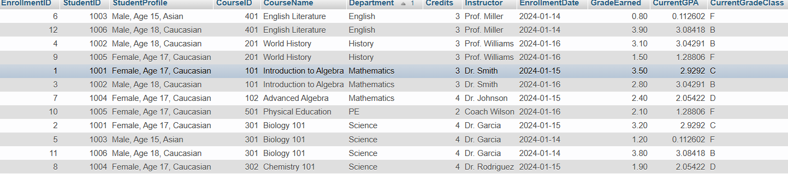
SQL QUESTION #14
Extract course enrollment details with student & course info.
SELECT
e.EnrollmentID,
s.StudentID,
CONCAT(s.Gender, ', Age ', s.Age, ', ', s.Ethnicity) AS StudentProfile,
c.CourseID,
c.CourseName,
c.Department,
c.Credits,
c.Instructor,
e.EnrollmentDate,
e.GradeEarned,
ap.GPA AS CurrentGPA,
ap.GradeClass AS CurrentGradeClass
FROM Enrollment e
JOIN Student s ON e.StudentID = s.StudentID
JOIN Courses c ON e.CourseID = c.CourseID
JOIN AcademicPerformance ap ON s.StudentID = ap.StudentID
ORDER BY c.Department, c.CourseID, s.StudentID
LIMIT 0, 25;
Notes:
Required inputting data

Slide 23
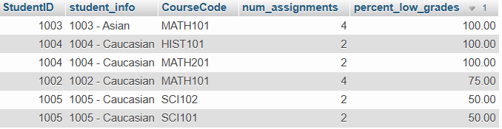
SQL QUESTION #15
Find students with declining performance.
SELECT
s.StudentID,
CONCAT(s.StudentID, ' - ', s.Ethnicity) AS student_info,
c.CourseCode,
COUNT(a.AssignmentID) AS num_assignments,
ROUND(
(SUM(CASE WHEN g.PointsEarned/a.MaxPoints * 100 < 70 THEN 1 ELSE 0 END) * 100.0) /
COUNT(a.AssignmentID),
2) AS percent_low_grades
FROM Student s
JOIN Grade g ON s.StudentID = g.StudentID
JOIN Assignment a ON g.AssignmentID = a.AssignmentID
JOIN Course c ON a.CourseID = c.CourseID
GROUP BY s.StudentID, student_info, c.CourseCode
HAVING percent_low_grades > 30
ORDER BY percent_low_grades DESC
LIMIT 0, 25;
Notes:
Required inputting data

Slide 24
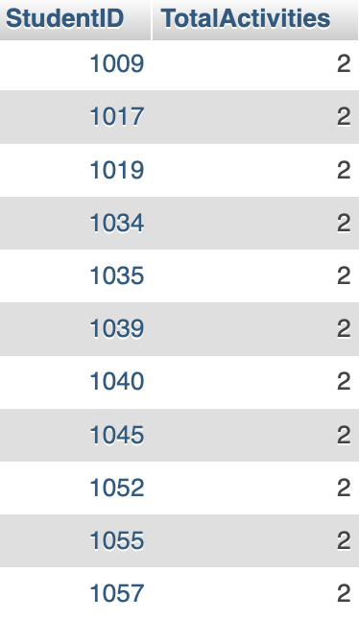
SQL QUESTION #16
Find students who are involved in two or more extracurricular activities
SELECT StudentID,
(Extracurricular + Sports + Music + Volunteering) AS TotalActivities
FROM ExtracurricularActivities
WHERE (Extracurricular + Sports + Music + Volunteering) >= 2;

Slide 25
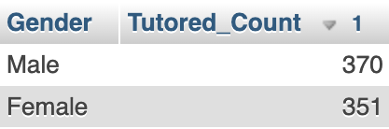
SQL QUESTION #17
Which gender has a higher proportion of students receiving tutoring?
SELECT Gender, COUNT(*) AS Tutored_Count
FROM Student s
JOIN StudyHabit sh ON s.StudentID = sh.StudentID
WHERE sh.Tutoring = 1
GROUP BY Gender
ORDER BY Tutored_Count DESC;

Slide 26
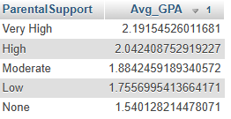
SQL QUESTION #18
Which parental support level is associated with the highest average GPA?
SELECT ParentalSupport, AVG(GPA) AS Avg_GPA
FROM ParentalInvolvement pi
JOIN AcademicPerformance ap ON pi.StudentID = ap.StudentID
GROUP BY ParentalSupport
ORDER BY Avg_GPA DESC;

Slide 27
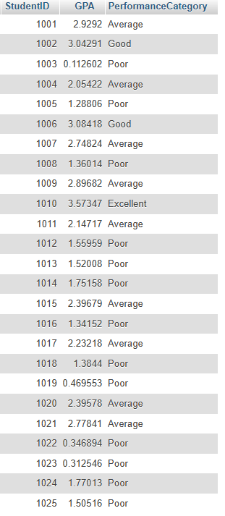
SQL QUESTION #19
Categorize students by GPA into performance tiers
SELECT StudentID, GPA,
CASE
WHEN GPA >= 3.5 THEN 'Excellent'
WHEN GPA >= 3.0 THEN 'Good'
WHEN GPA >= 2.0 THEN 'Average'
ELSE 'Poor'
END AS PerformanceCategory
FROM AcademicPerformance;

Slide 28
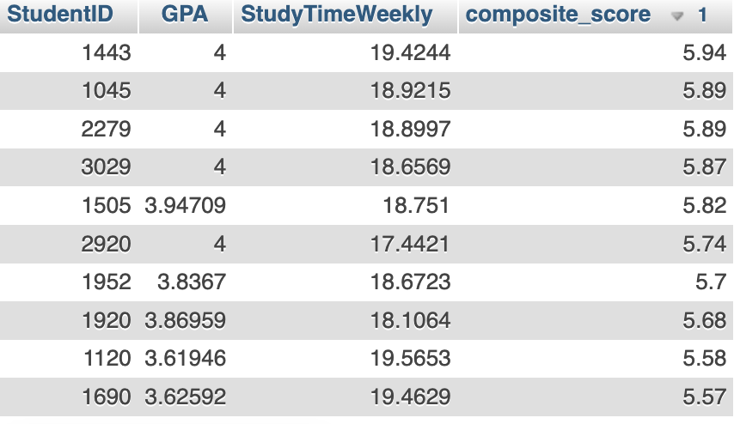
SQL QUESTION #20
Which students are the most successful when we combine academic performance and study effort?
SELECT
s.StudentID,
ap.GPA,
sh.StudyTimeWeekly,
ROUND(ap.GPA + (sh.StudyTimeWeekly * 0.1), 2)
AS composite_score
FROM Student s
JOIN AcademicPerformance ap ON s.StudentID = ap.StudentID
JOIN StudyHabit sh ON s.StudentID = sh.StudentID
ORDER BY composite_score DESC
LIMIT 10;

Slide 29
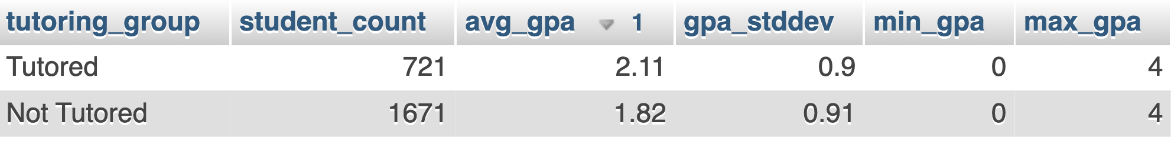
SQL QUESTION #21
Does tutoring lead to better or more consistent academic performance?
SELECT
s.StudentID,
sh.StudyTimeWeekly,
ap.GPA,
ROUND(ap.GPA / NULLIF(sh.StudyTimeWeekly, 0), 2) AS gpa_efficiency
FROM Student s
JOIN StudyHabit sh ON s.StudentID = sh.StudentID
JOIN AcademicPerformance ap ON s.StudentID = ap.StudentID
WHERE sh.StudyTimeWeekly >= 10 AND ap.GPA < 2.5
ORDER BY gpa_efficiency ASC;

Slide 30
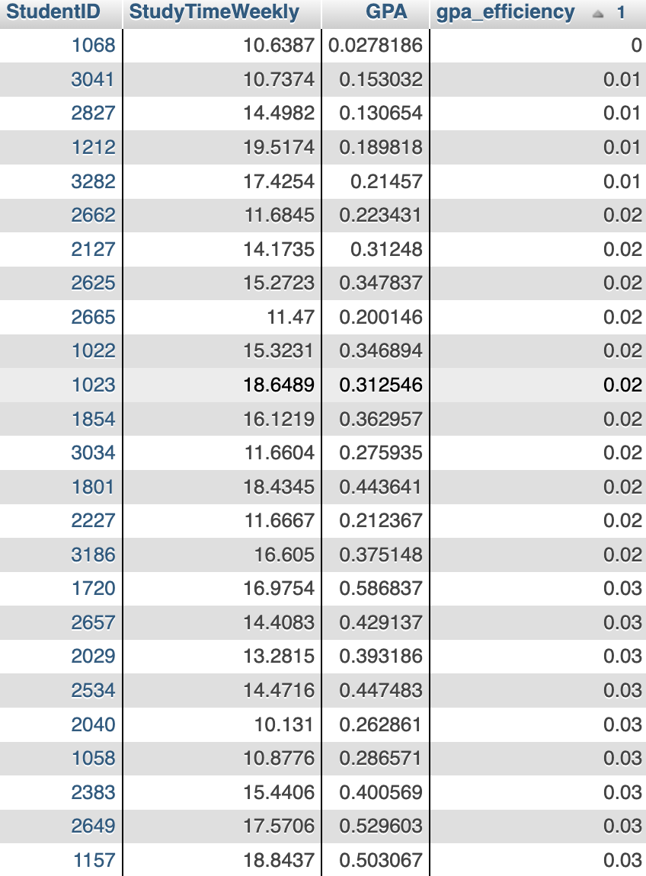
SQL QUESTION #22
Which students are putting in a lot of study time but not getting good grades?
SELECT
s.StudentID,
sh.StudyTimeWeekly,
ap.GPA,
ROUND(ap.GPA / NULLIF(sh.StudyTimeWeekly, 0), 2) AS gpa_efficiency
FROM Student s
JOIN StudyHabit sh ON s.StudentID = sh.StudentID
JOIN AcademicPerformance ap ON s.StudentID = ap.StudentID
WHERE sh.StudyTimeWeekly >= 10 AND ap.GPA < 2.5
ORDER BY gpa_efficiency ASC;

Slide 31
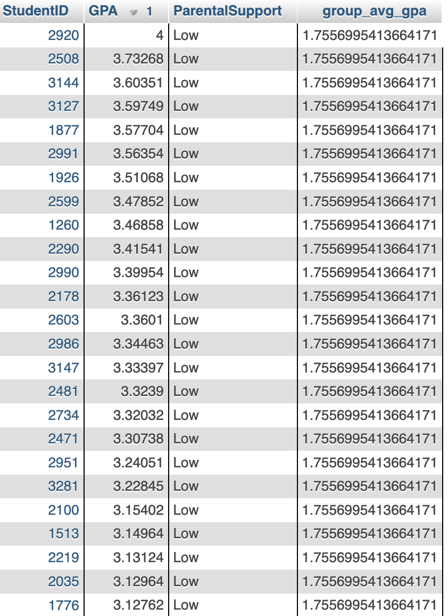
SQL QUESTION #23
Within students with low parental support, who exceeds the group average GPA?
SELECT
s.StudentID,
ap.GPA,
pi.ParentalSupport,
group_stats.avg_gpa AS group_avg_gpa
FROM Student s
JOIN ParentalInvolvement pi ON s.StudentID = pi.StudentID
JOIN AcademicPerformance ap ON s.StudentID = ap.StudentID
JOIN (
SELECT pi.ParentalSupport, AVG(ap.GPA) AS avg_gpa
FROM ParentalInvolvement pi
JOIN AcademicPerformance ap ON pi.StudentID = ap.StudentID
GROUP BY pi.ParentalSupport
) group_stats ON pi.ParentalSupport = group_stats.ParentalSupport
WHERE pi.ParentalSupport = 'Low' AND ap.GPA > group_stats.avg_gpa
ORDER BY ap.GPA DESC;

Slide 32
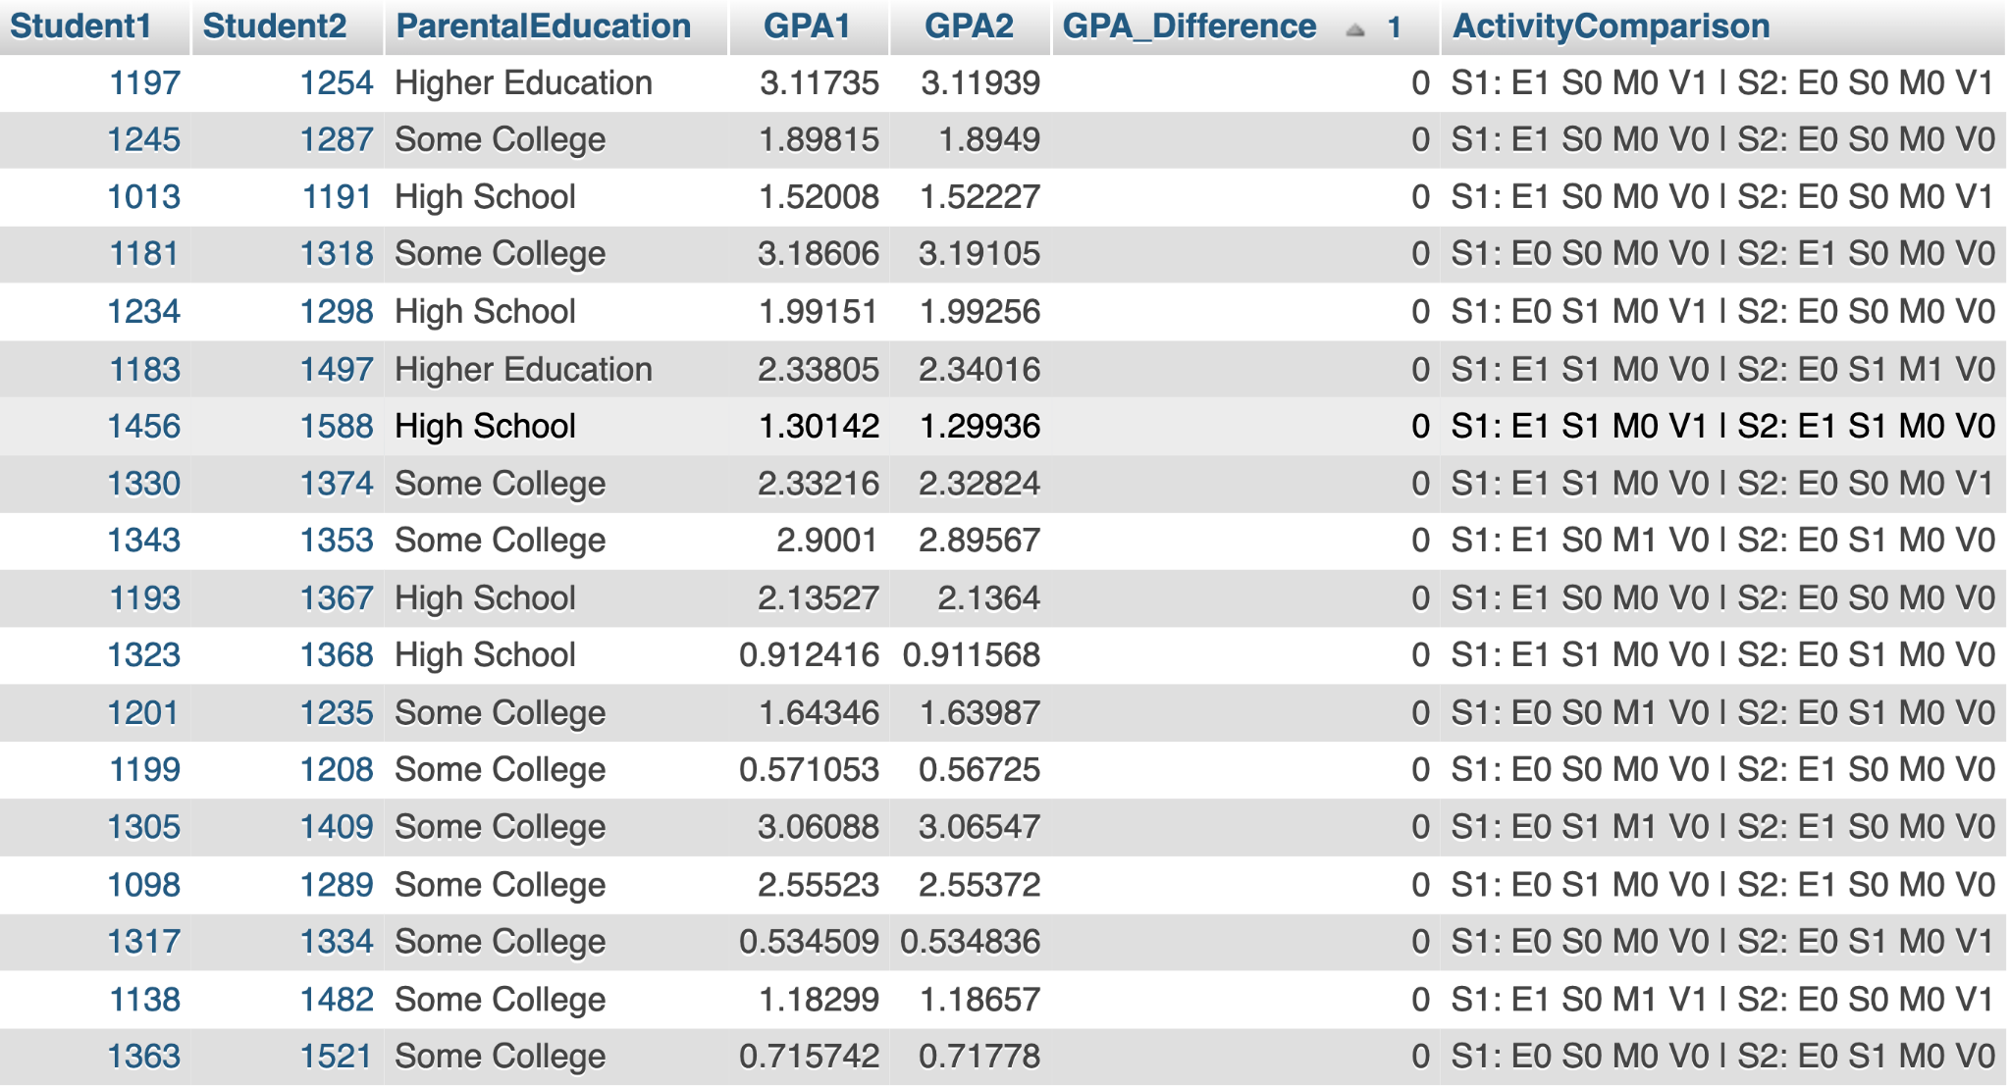
SQL QUESTION #24
Which pair of students have the same parental education level, very similar GPAs (within 0.2), and completely different activity profiles?
SELECT
s1.StudentID AS Student1,
s2.StudentID AS Student2,
pi1.ParentalEducation,
ap1.GPA AS GPA1,
ap2.GPA AS GPA2,
ROUND(ABS(ap1.GPA - ap2.GPA), 2) AS GPA_Difference,
CONCAT(
'S1: E', ea1.Extracurricular, ' S', ea1.Sports,
' M', ea1.Music, ' V', ea1.Volunteering,
' | S2: E', ea2.Extracurricular, ' S', ea2.Sports,
' M', ea2.Music, ' V', ea2.Volunteering
) AS ActivityComparison
FROM Student s1
JOIN Student s2
ON s1.StudentID < s2.StudentID
JOIN ParentalInvolvement pi1 ON s1.StudentID = pi1.StudentID
JOIN ParentalInvolvement pi2 ON s2.StudentID = pi2.StudentID
AND pi1.ParentalEducation = pi2.ParentalEducation
JOIN AcademicPerformance ap1 ON s1.StudentID = ap1.StudentID
JOIN AcademicPerformance ap2 ON s2.StudentID = ap2.StudentID
AND ABS(ap1.GPA - ap2.GPA) <= 0.2
JOIN ExtracurricularActivities ea1 ON s1.StudentID = ea1.StudentID
JOIN ExtracurricularActivities ea2 ON s2.StudentID = ea2.StudentID
WHERE
(ea1.Extracurricular <> ea2.Extracurricular OR
ea1.Sports <> ea2.Sports OR
ea1.Music <> ea2.Music OR
ea1.Volunteering <> ea2.Volunteering)
ORDER BY GPA_Difference;

Slide 33
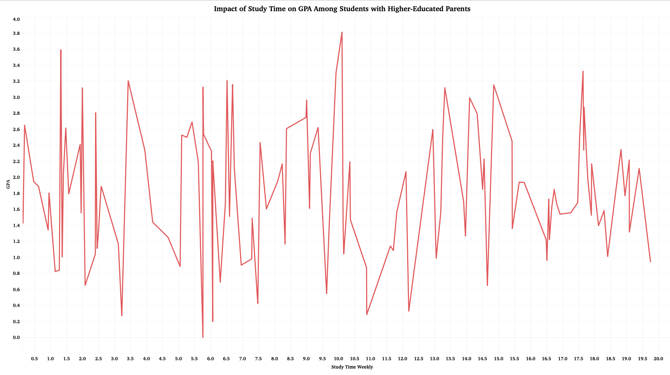

Slide 34
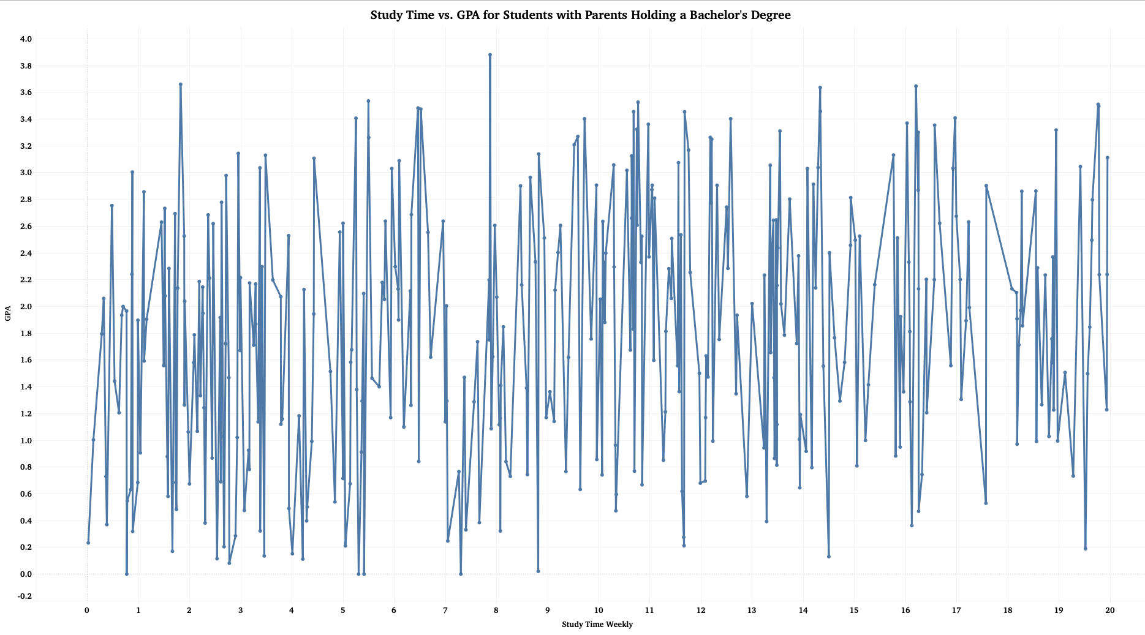

Slide 35
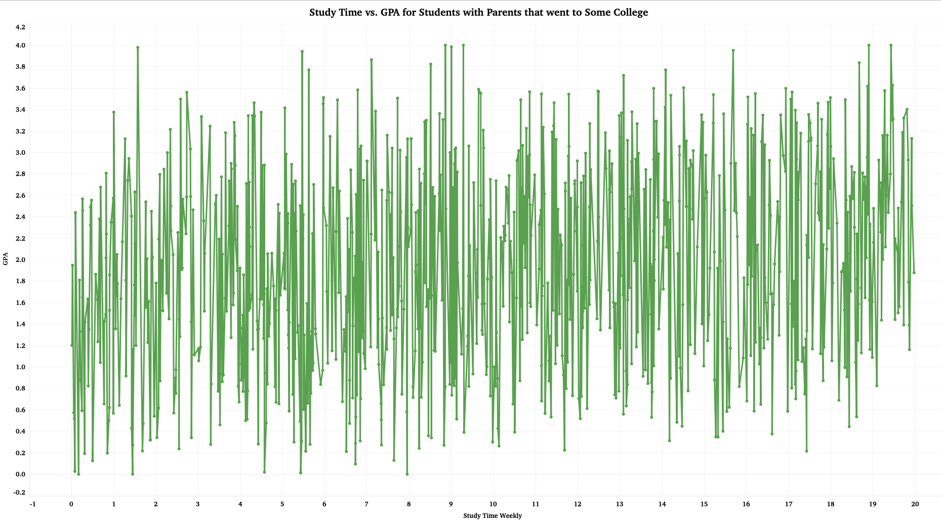

Slide 36
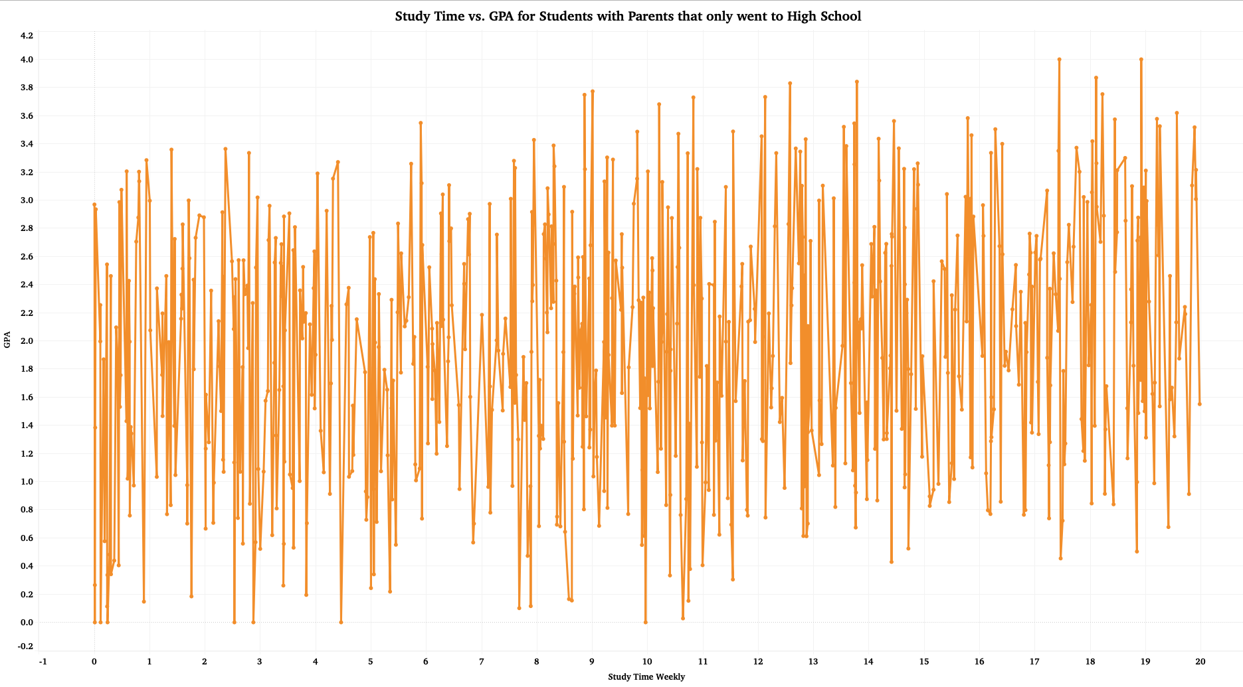

Slide 37
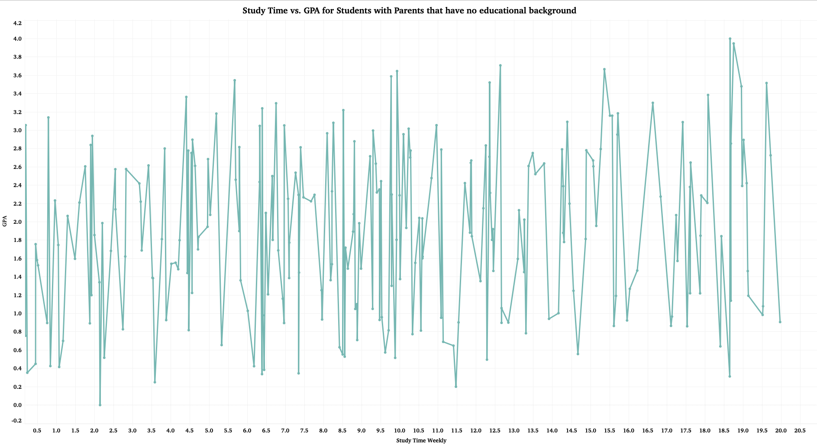

Slide 38
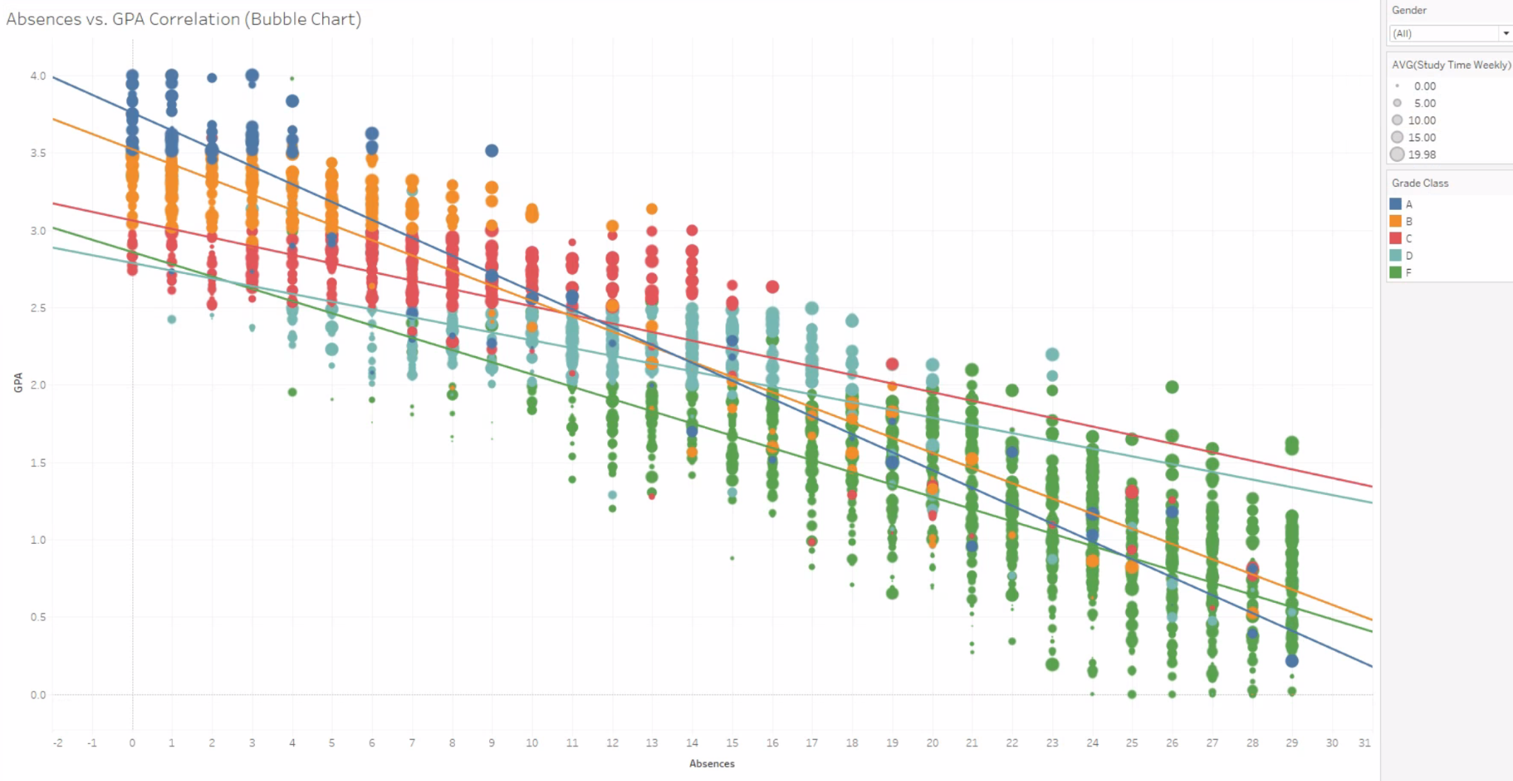

Slide 39
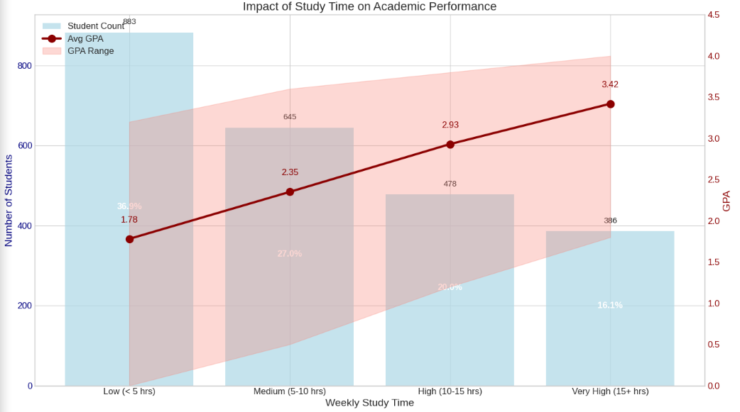

Slide 40
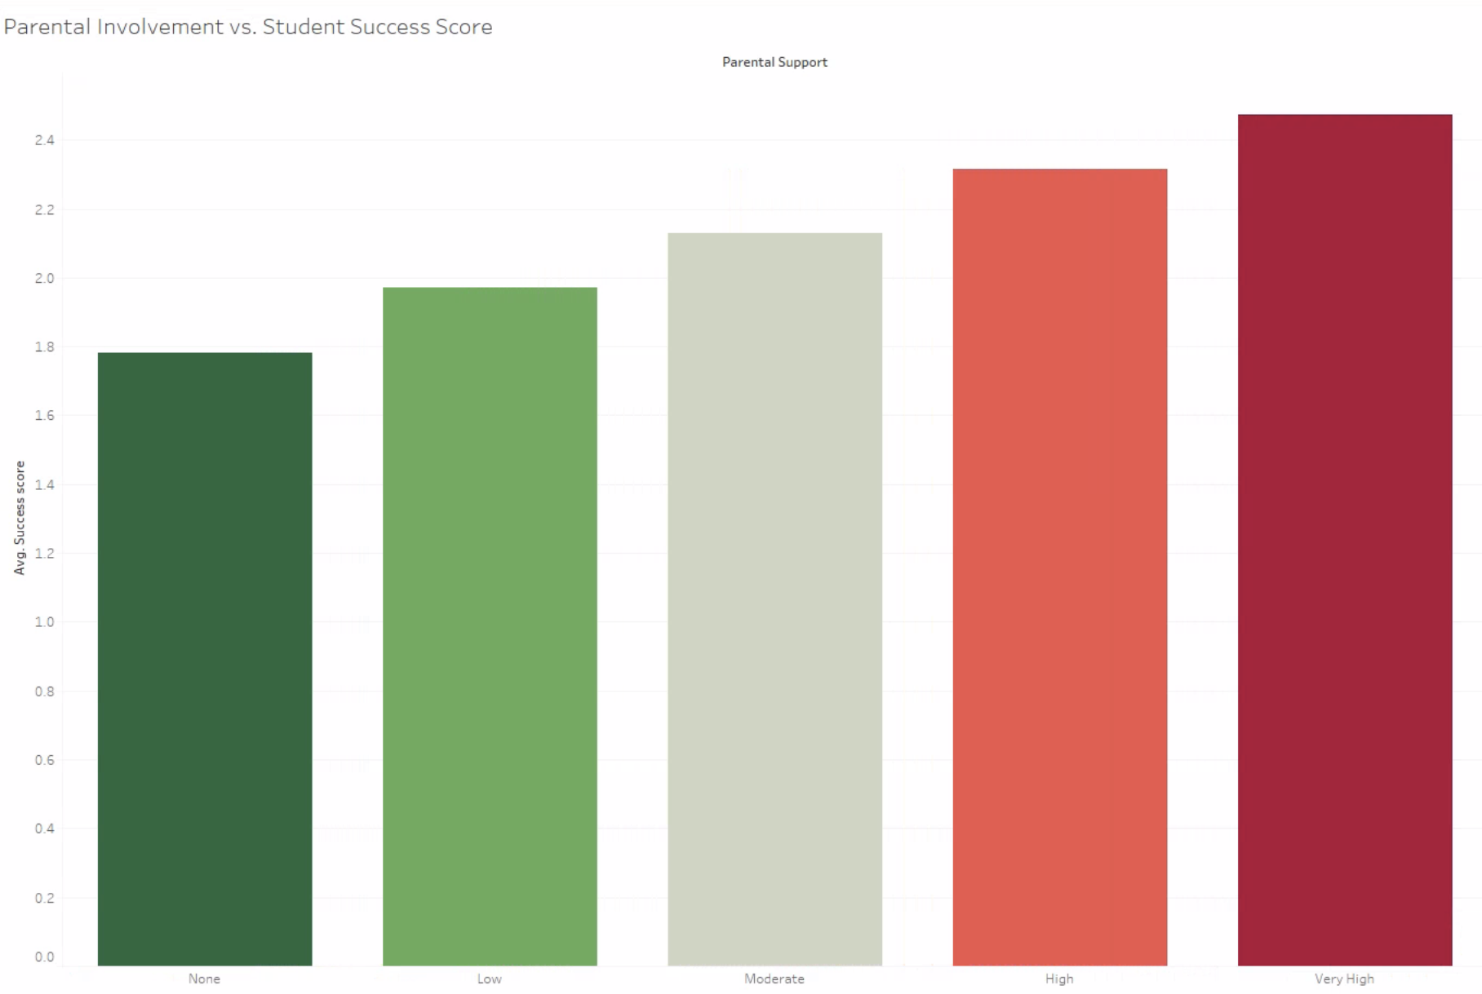
Notes:
GPA+(0.1×StudyTime)−(0.05×Absences)

Slide 41
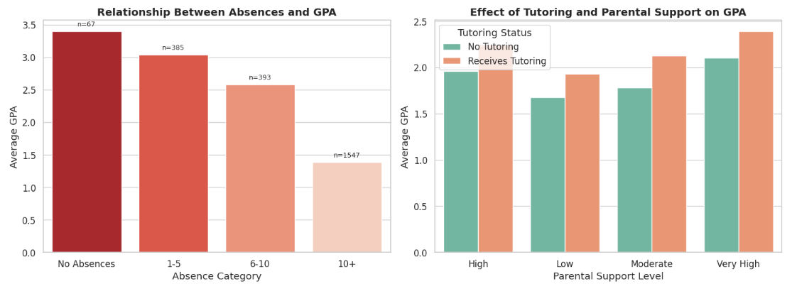
Notes:
Strong absence-GPA correlation: Perfect attendance correlates with the highest GPA (~3.4), while excessive absences (10+) reduce GPA to failing levels (~1.4), highlighting attendance as a critical performance factor.
Students receiving tutoring outperform non-tutored peers across all parental support levels, with GPA improvements ranging from 0.2 to 0.5 points.
Parental support amplifies tutoring: The tutoring benefit is most pronounced with "Very High" parental support, suggesting that home reinforcement maximizes the effectiveness of academic interventions.
Combined interventions most effective: The data indicates that addressing both attendance issues and implementing support systems (tutoring + parental engagement) would yield the most significant improvements in student performance.

Slide 42
THANK YOU!

